Slide 1
Google Fiber Project
File created on: 12/2/2024 6:45:35 AM

Slide 2


Slide 3
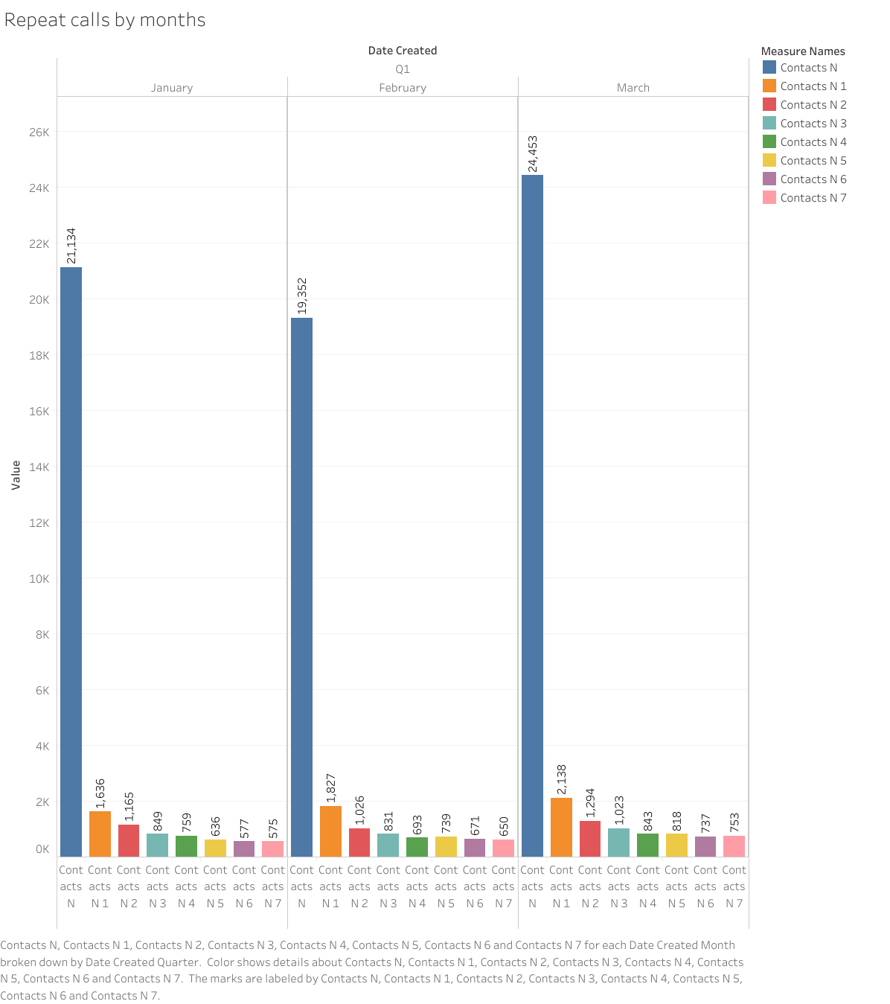

Slide 4
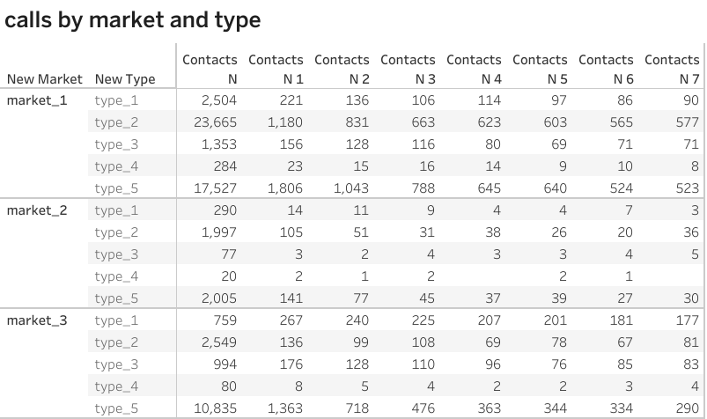

Slide 5
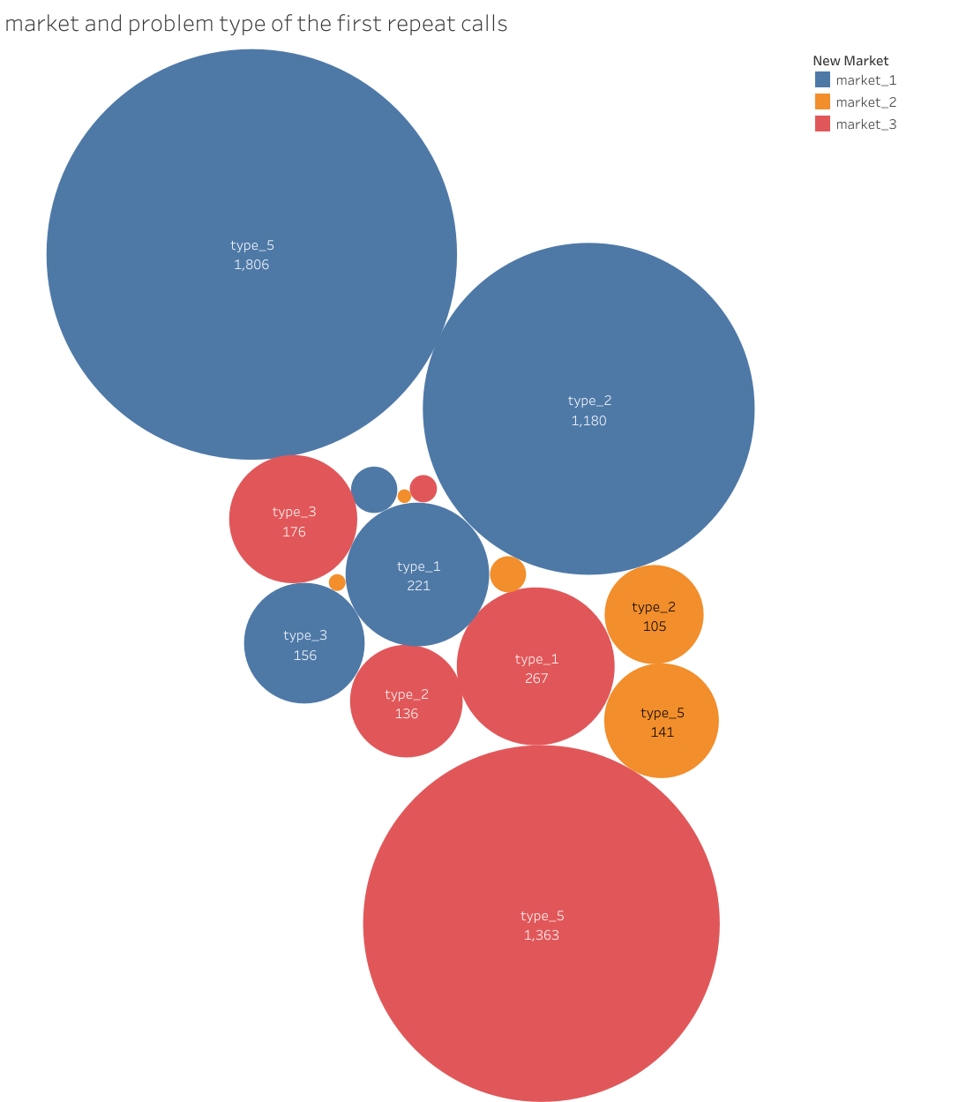

Slide 6
